Slide 1
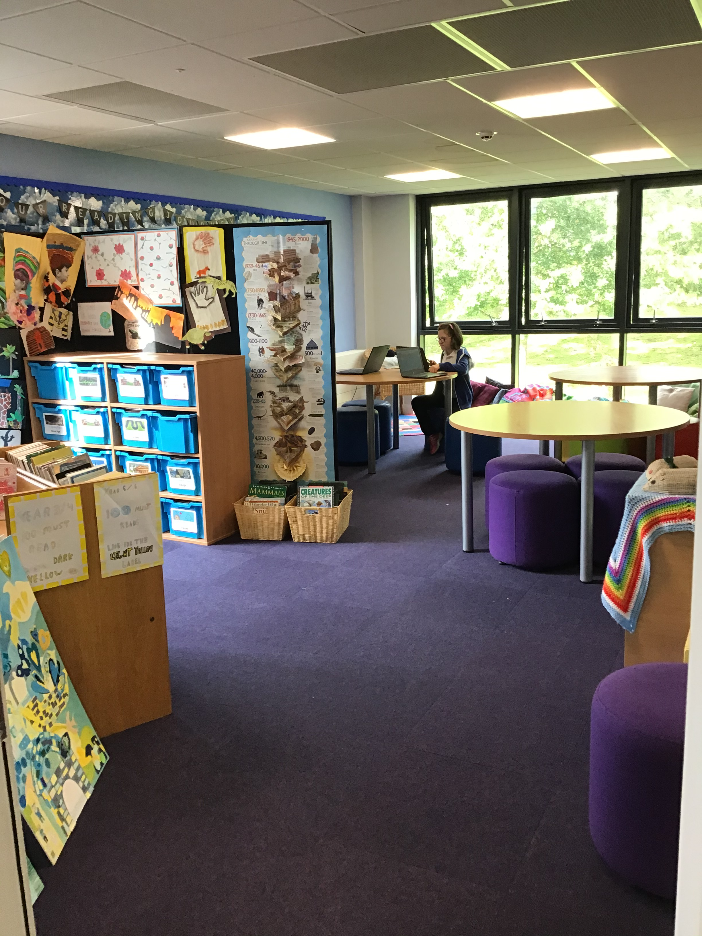
Hello from the Library!

Slide 2
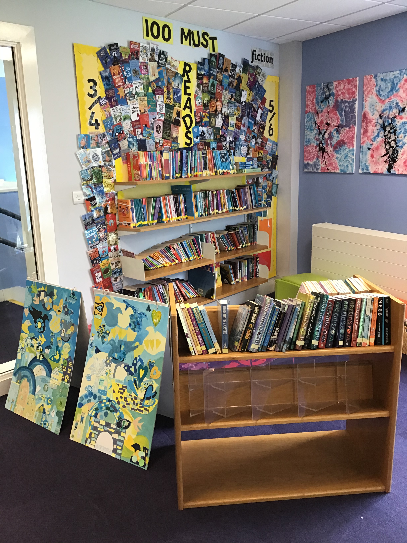
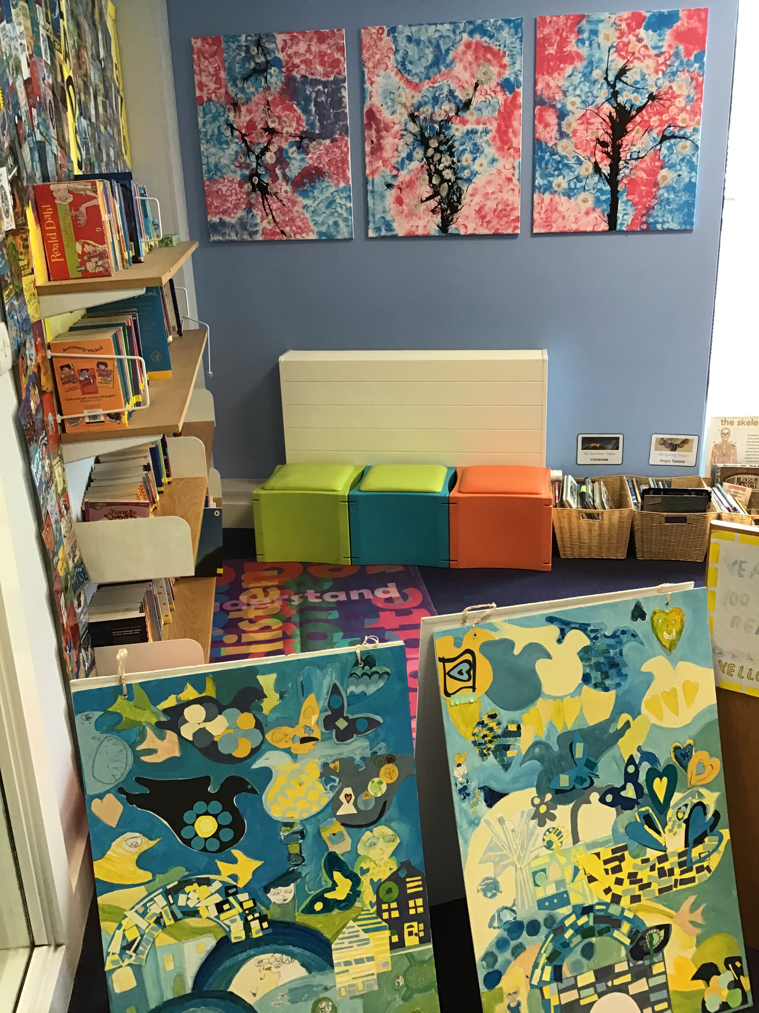
On the left as soon as you come in…
How many can you read?

Slide 3
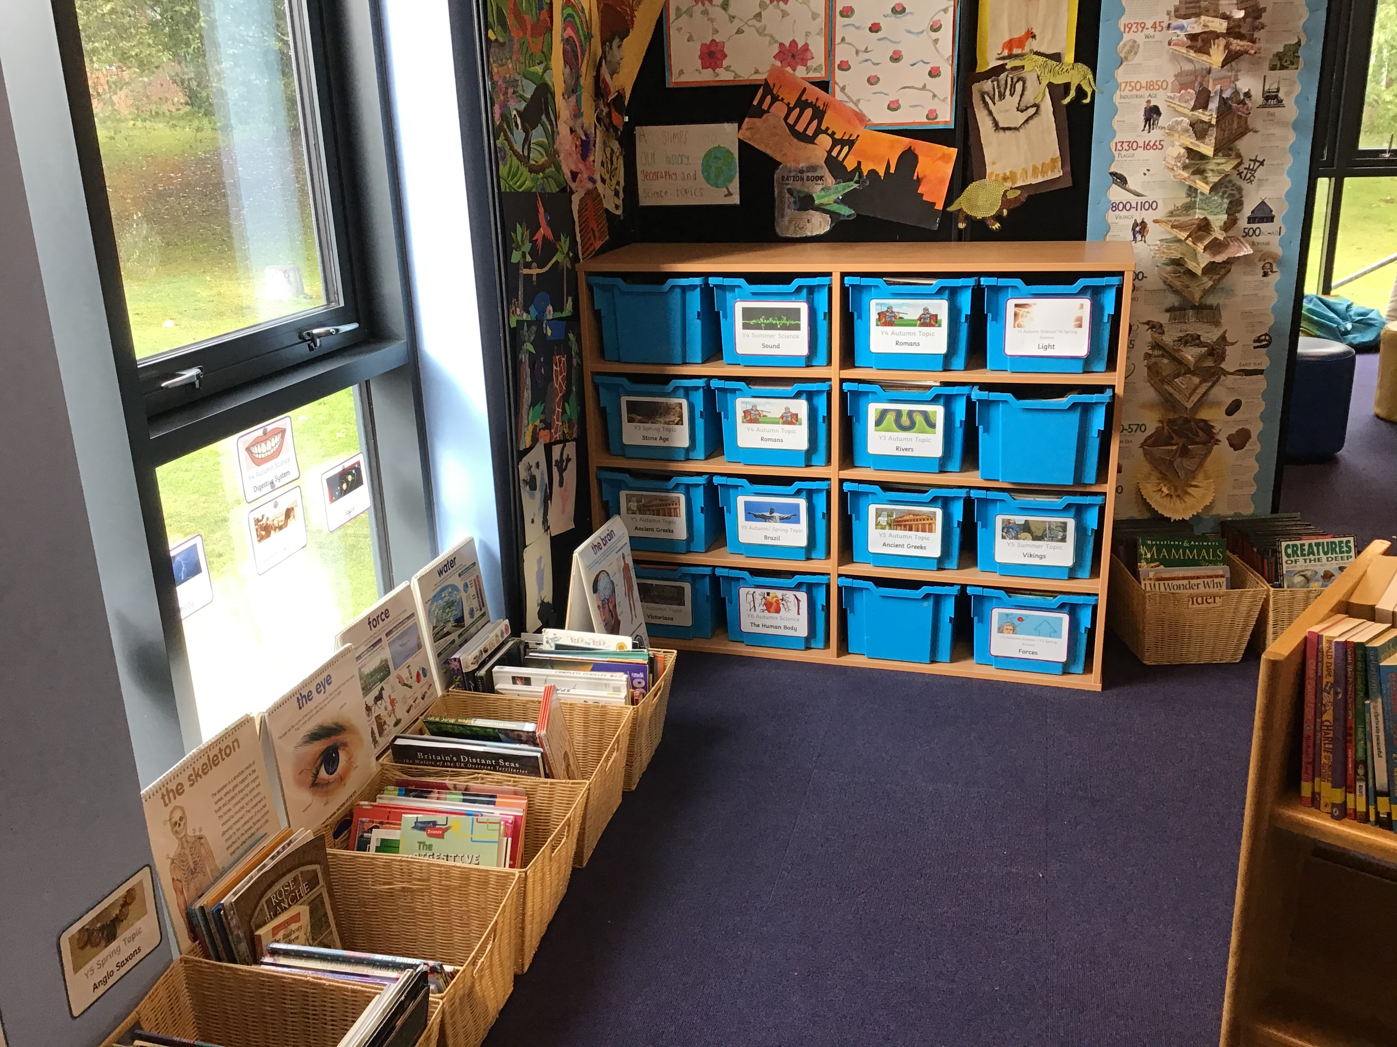
Your class can collect your year’s Topic and Science book boxes to help your learning.

Slide 4
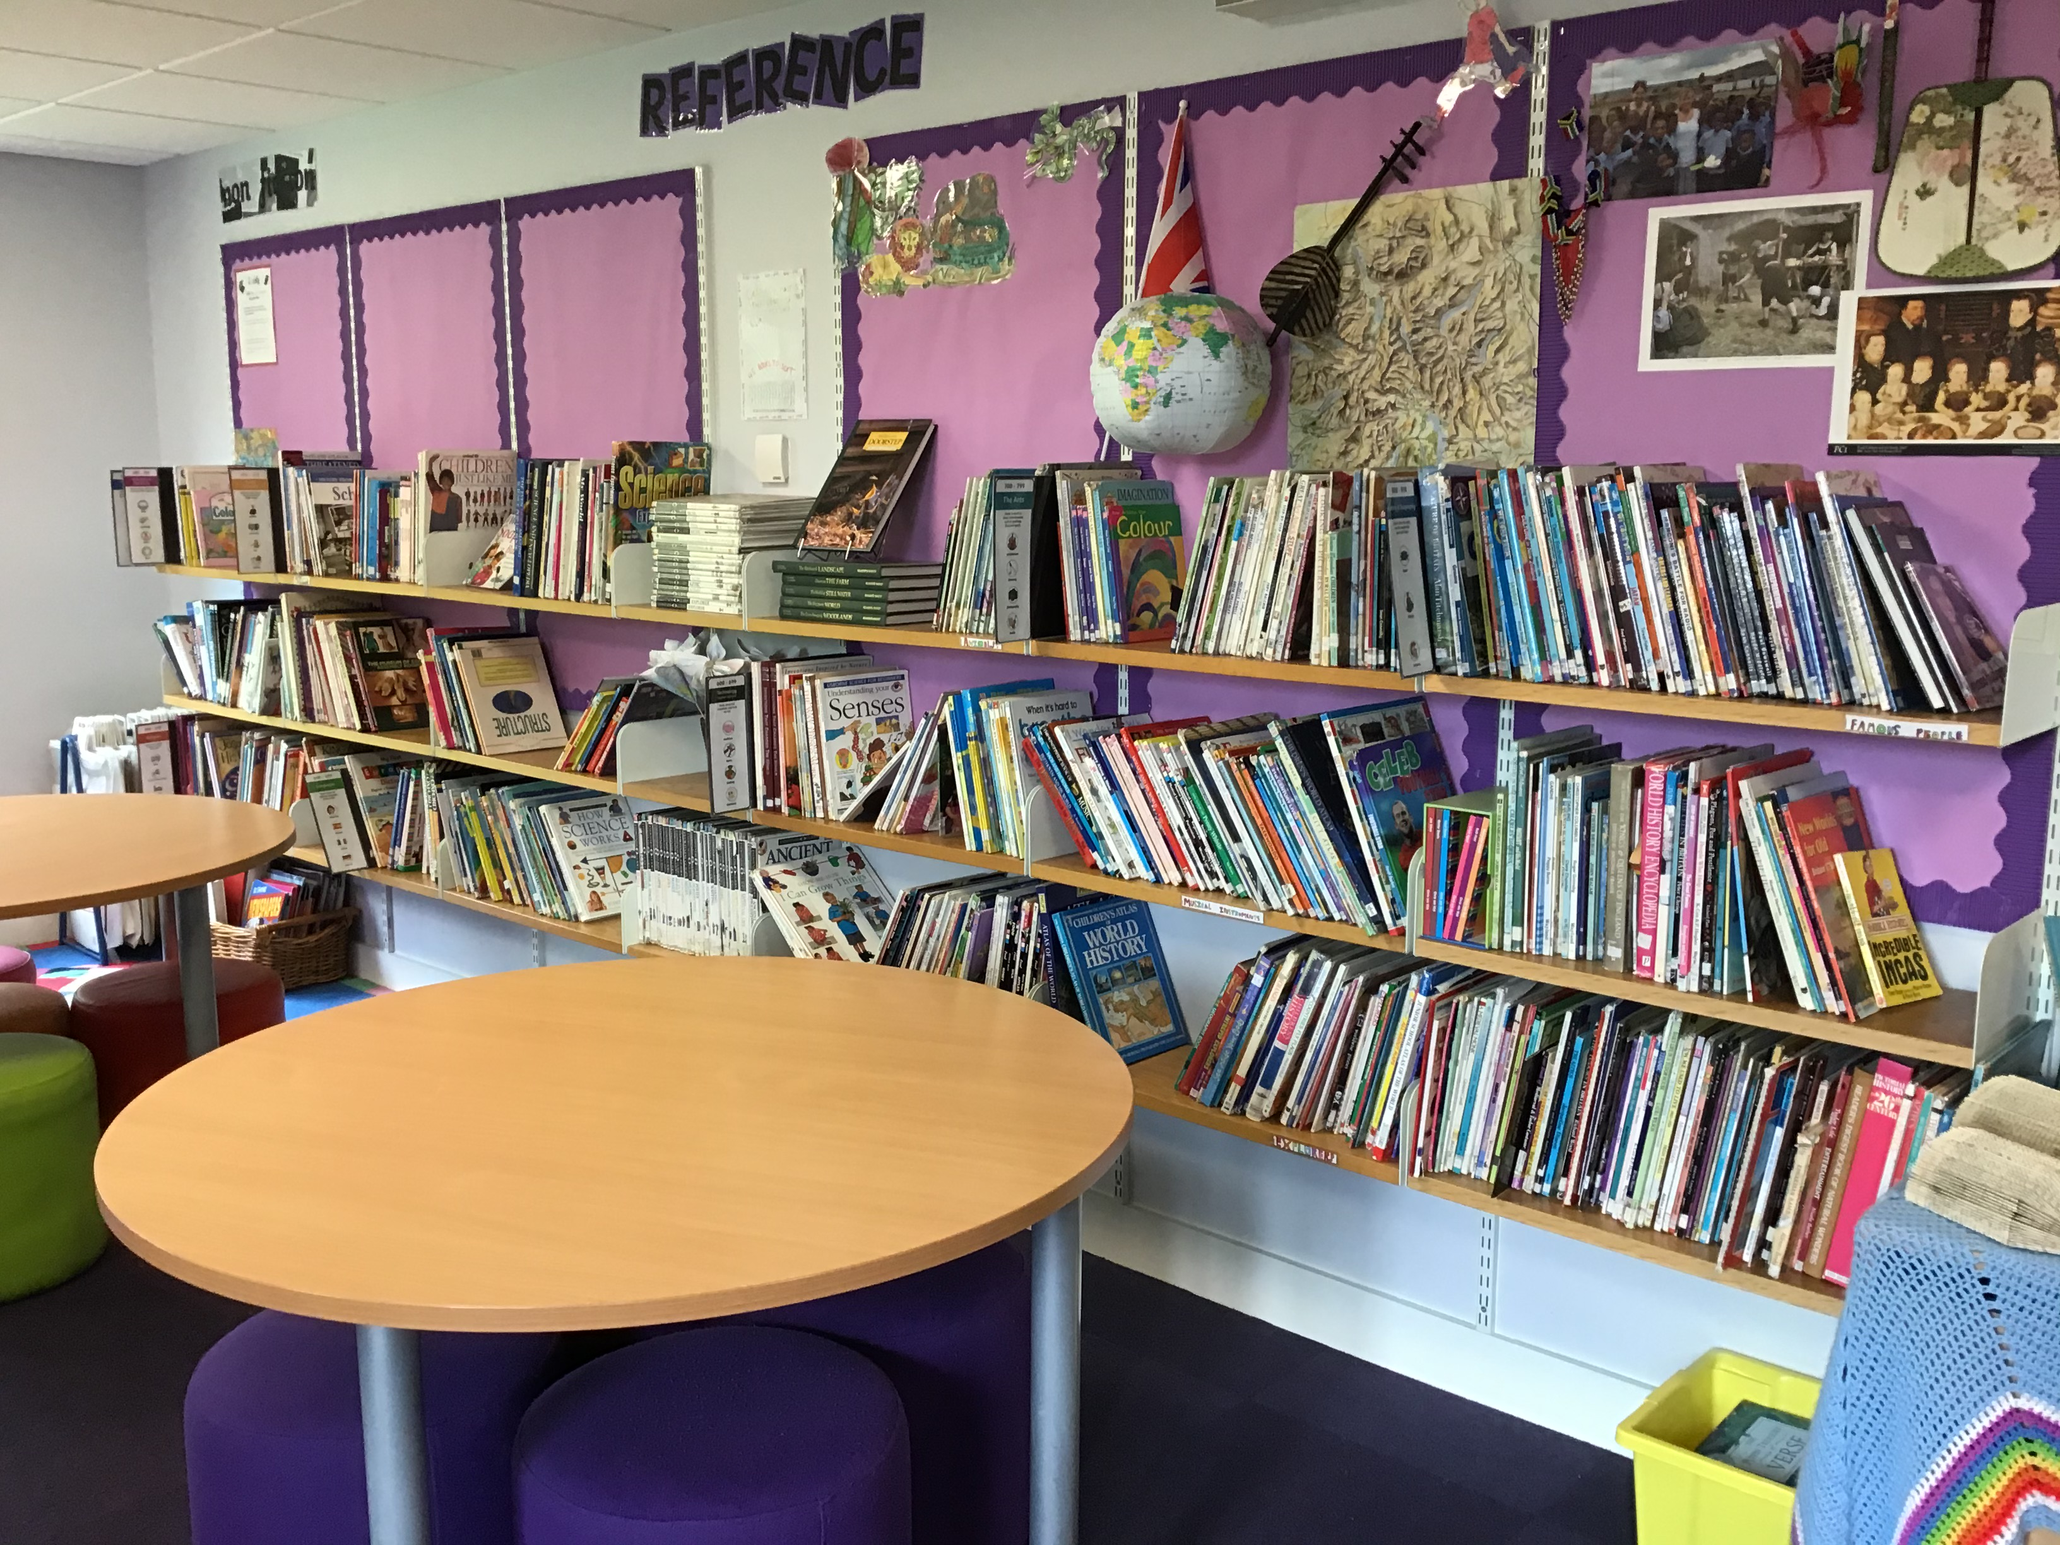
Along the right –hand side wall, is our reference section.
It’s ‘Non-fiction November’ soon!

Slide 5
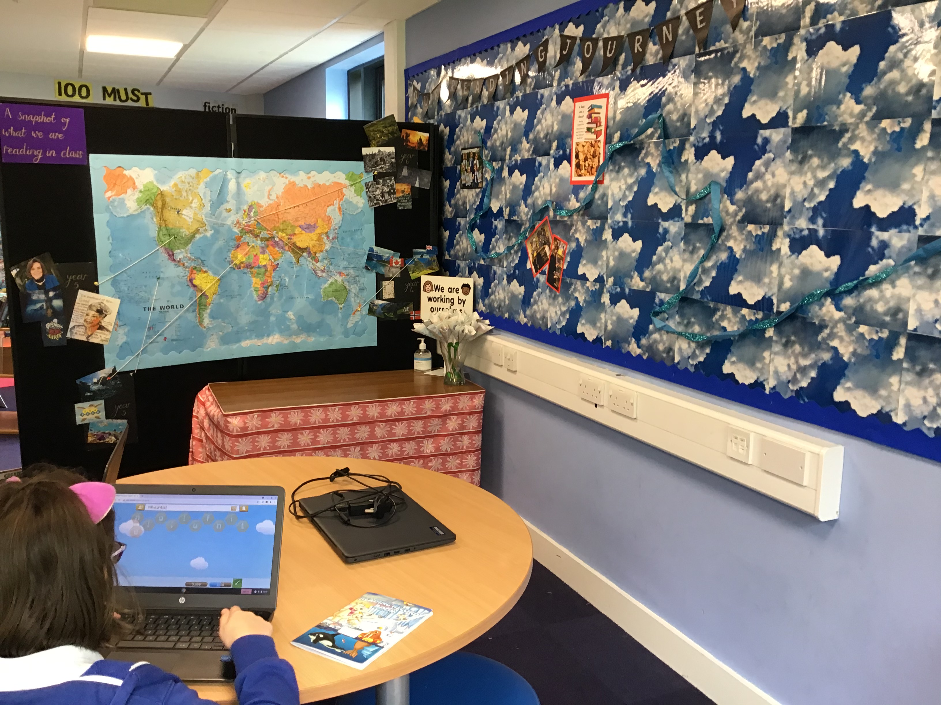
Check out our reading learning journey: it tells you what’s already happened as well as what’s coming up!

Slide 6
The world map tracks the reading we are doing across the school.

Slide 7
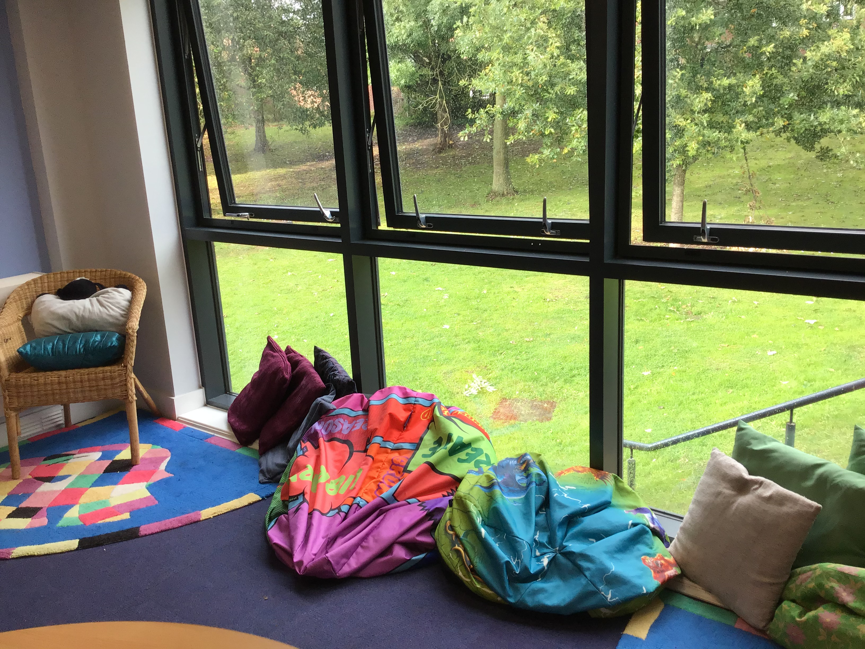
And, lastly, this is the cosy corner.
Come down and enjoy a book here!

